Slide 1

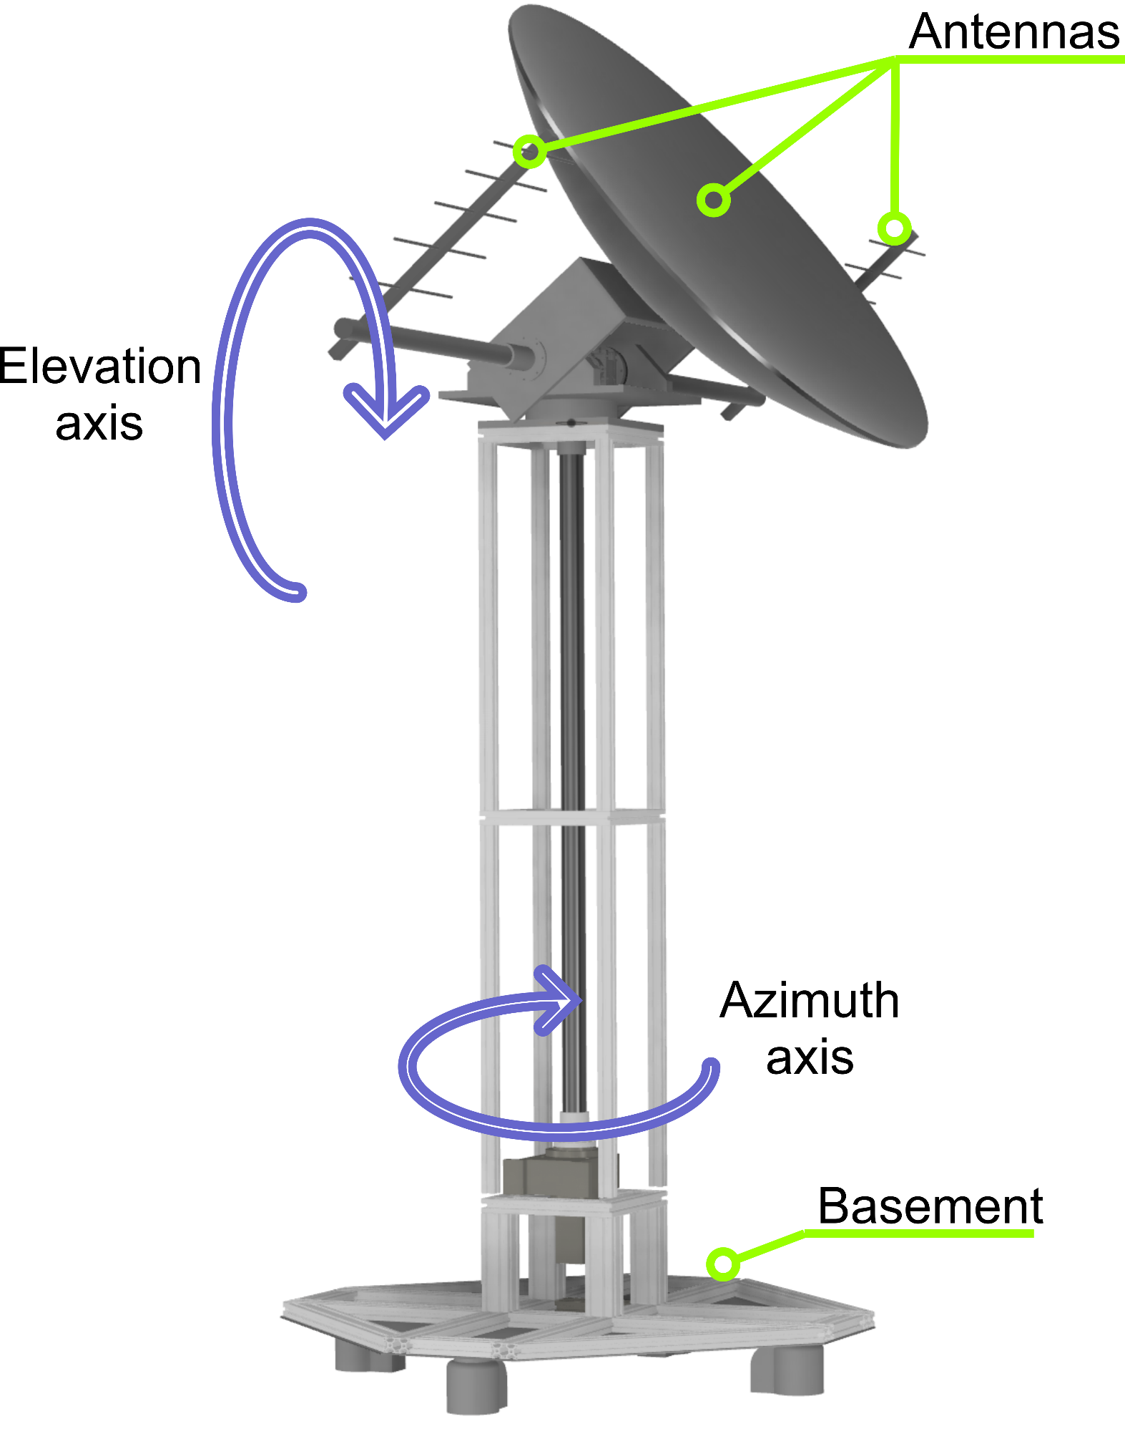
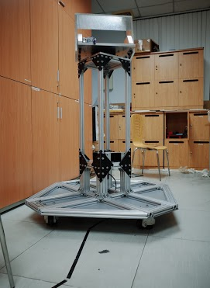
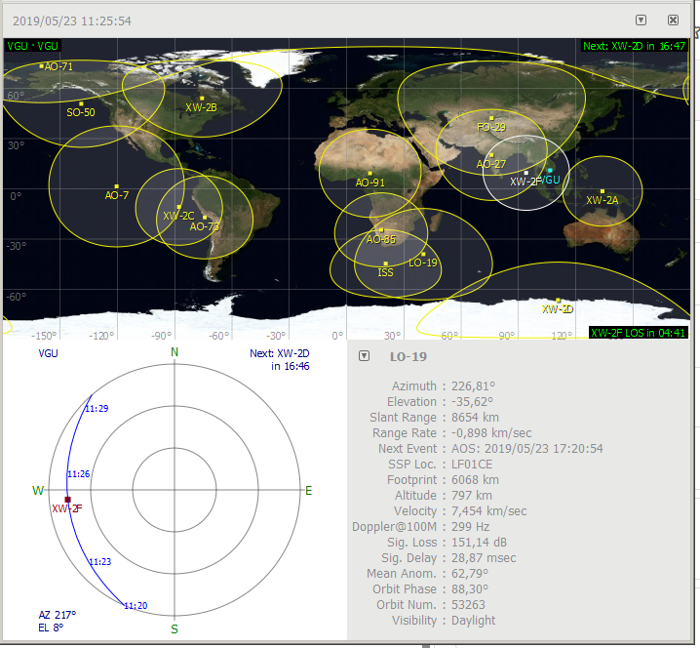
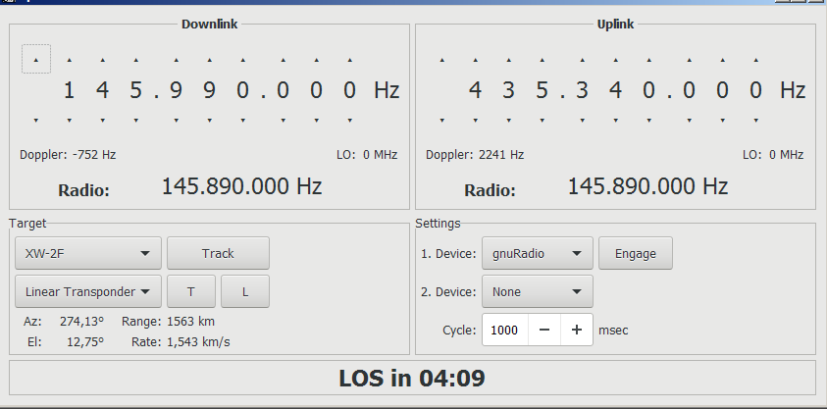
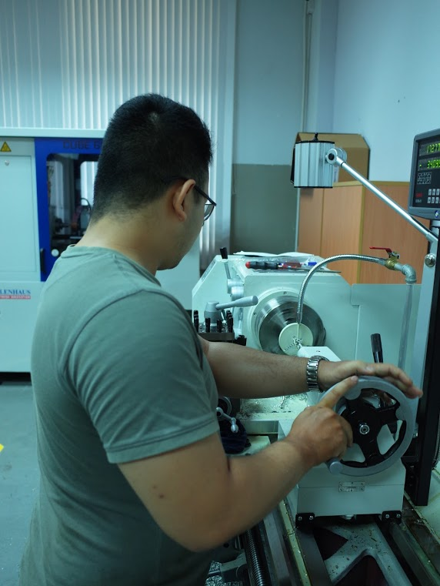
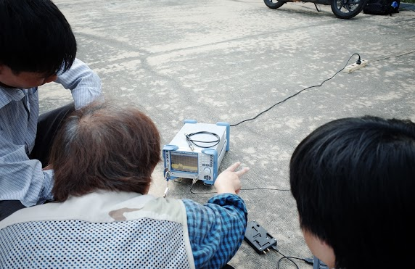
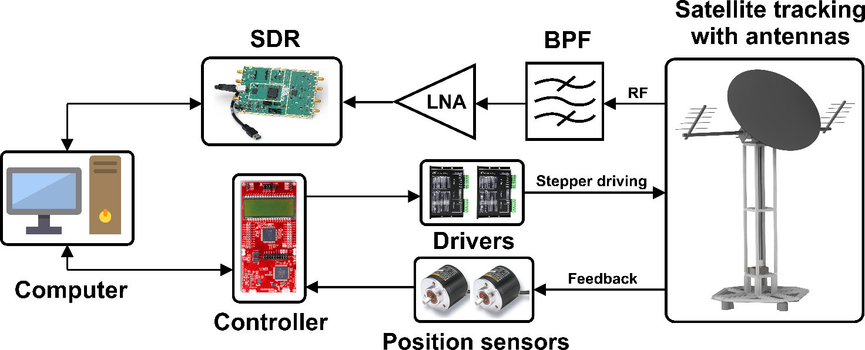
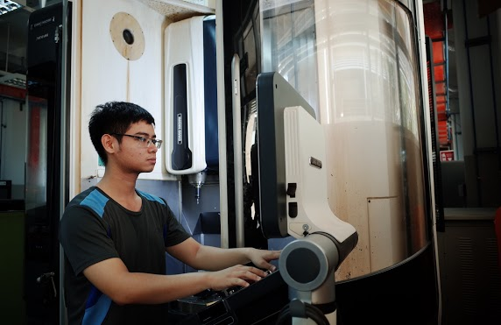
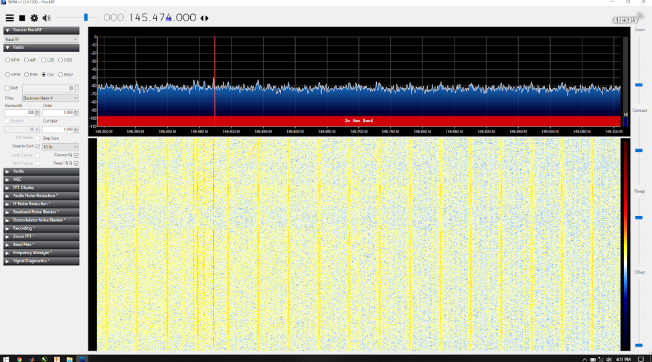
Satellite Ground Station Using Software-Defined Radio
Nguyễn Văn Hóa Vũ, Nguyễn Minh Dũng, Lê Tự Quốc Nghi, Võ Thành Đạt, Trần Anh Khoa, Trần Lê Hoàng
Faculty: Faculty of Engineering MSST and ME
Instructor & supervisor: Dr. Võ Bích Hiển
Problem
Procedure
Satellite Tracking Algorithms
Development of a real-time radio Satellite Ground Station system that can receiving control signals and communicating with high accuracy and efficiency
Satellite position acquisition
Antenna positioning
Signal acquisition
Data analyzing
After doing research on Keplerian orbit, the ECEF coordinate system, Julian date and time, we build the Algorithms base on these following step
Acquire epoch, mean anomaly, eccentricity,.... information from TLE
Construct velocity and position vector of satellite in True Earth Mean Equinox system
Convert data from the TEME to ECEF coordinate system
Generate latitude, longitude and altitude from ECEF position matrix
Calculate the azimuth and elevation angle in real time
Project overview
Utilizing DSP engine and open-source SDR hardware designed by Matt Ettus to design and construct a radio Satellite Ground Station system
The system consists of rotational system for satellite tracking, controller, an SDR interface program for frequency switching and signal processing.
The mechanical structure will allow the oriented antenna rotating in both azimuth and elevation axis. It is expected to work outside with wind and rain resistance.
To manipulate this rotational system, we need to program a software running on computer to allow it working in both manual and automatic mode
Results
The system functioned and operated normally providing information of the satellite being tracked
The result is then verified with GPREGICT
Flow of RF signal and tuning mechanism
Conclusion
By participating in a pioneer project like this in Vietnam, we engaged ourselves with great challenge due to the time and budget constraint.
However, upon the completion of the project, new door of opportunities including commercial benefits will open before us. This will also ignite the spark of inspiration on space engineering in VGU
Project site https://sites.google.com/view/satgndstat
www.vgu.edu.vn

